Slide 1
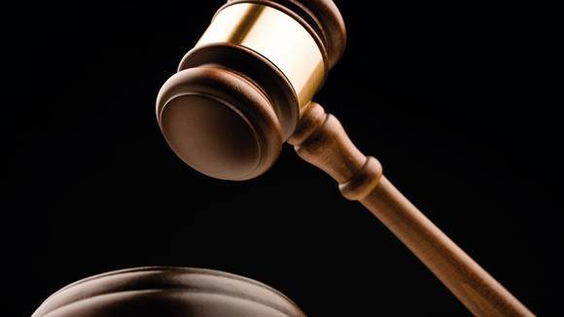
Isaiah 1
When God Takes His People to Court
Dr. Rick Griffith, Crossroads International Church, Singapore
www.biblestudydownloads.com

Slide 2
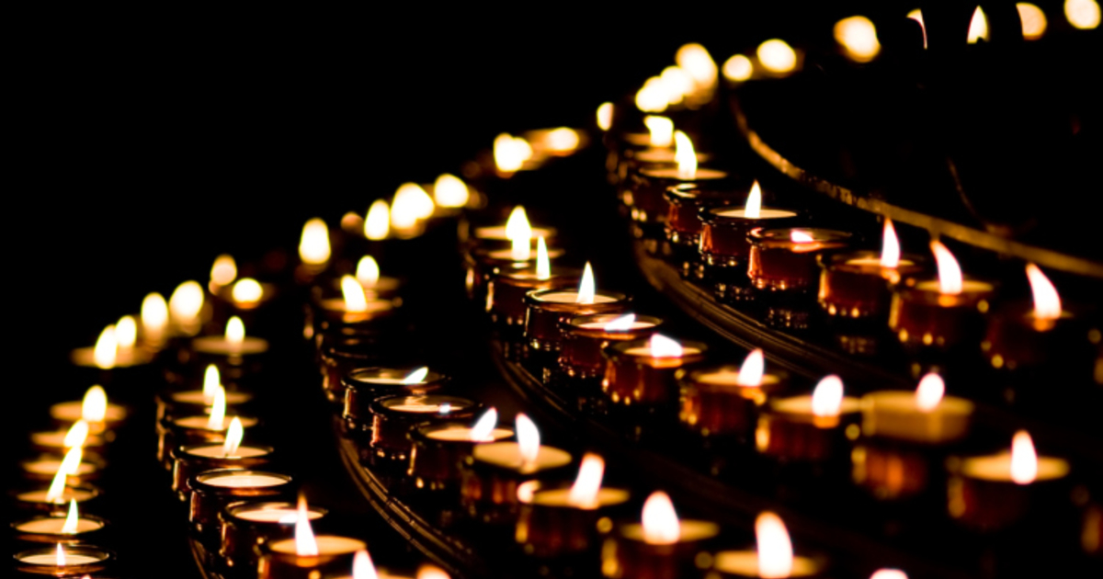
Christian Rituals
Subtitle

Slide 3
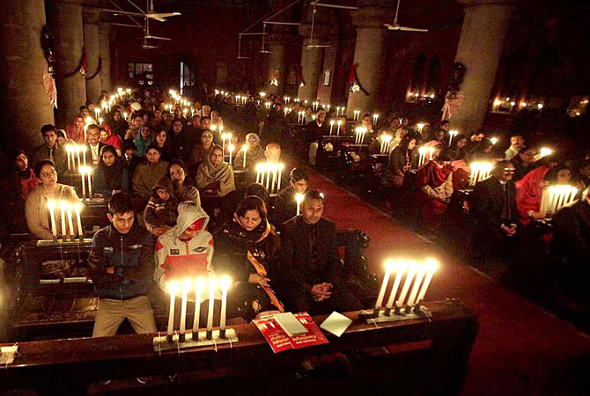
Church Services
Religious Rituals Today

Slide 4

Candles
Religious Rituals Today

Slide 5
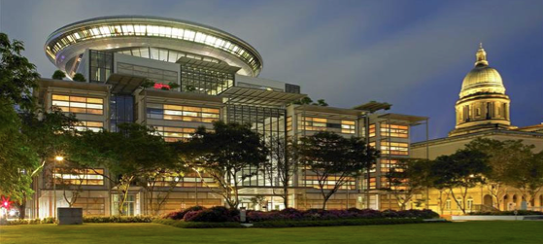
Supreme Court, Singapore

Slide 6
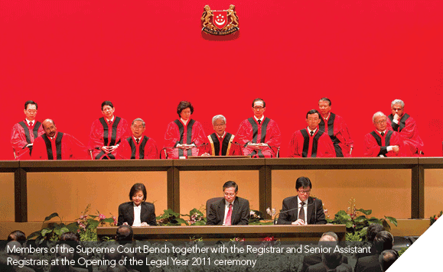
Supreme Court, Singapore

Slide 7
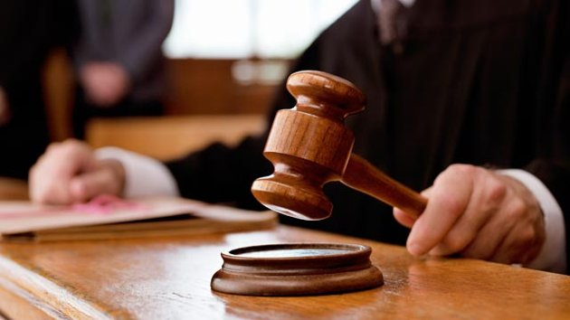
The Justice System
Does it give justice?

Slide 8
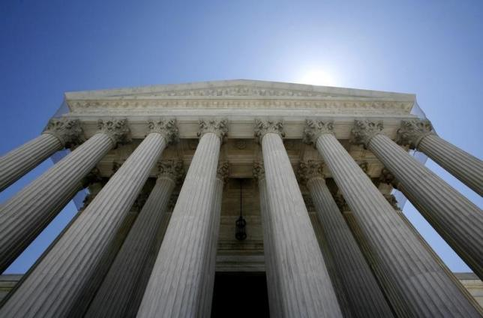
The Supreme Court is Not the Supreme Judge
Obviously, God is.
Notes:
How would you fair if the Judge knew your motives for rituals completely?
Do you trust religious rituals more than a relationship with the Judge?
Are you involved in any injustice?

Slide 9
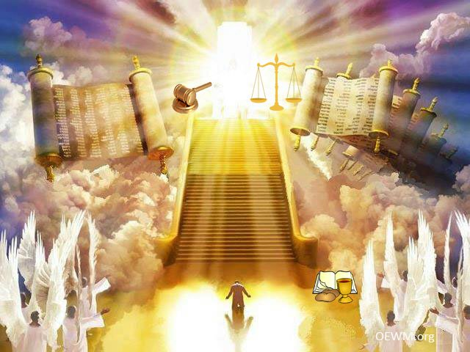
How should we respond to an all-knowing Judge who takes us to court?
You

Slide 10
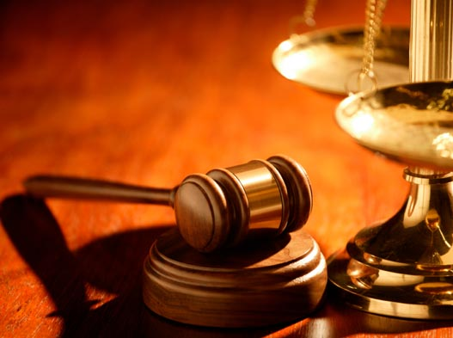
Isaiah 1
One of the most famous court cases in history…

Slide 11
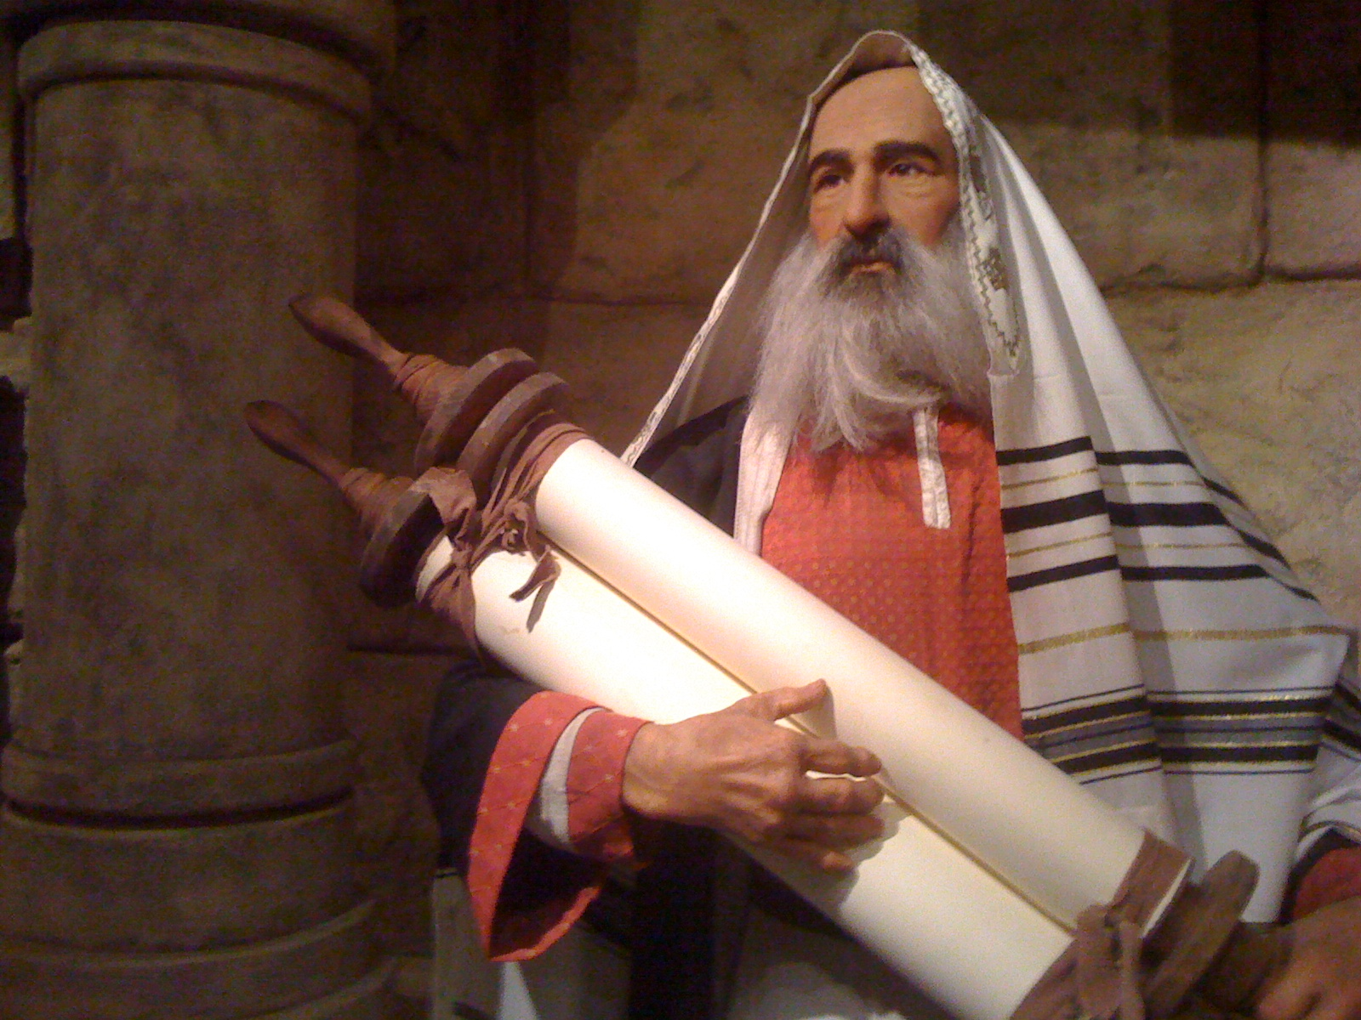
Who was Isaiah?
"The LORD is salvation"
Notes:
Isaiah married a prophetess (8:3) and had two sons: Shear-Jashub (7:3) and Shalal-Hash-Baz (8:3). Isaiah probably lived in Jerusalem as he had access to the royal court (7:3; 36:1–38:8; cf. 2 Kings 18:3–20:19; 2 Chron. 26:22).
Tradition says he was a cousin of King Uzziah (Talmud Meg. 10b), but no firm evidence supports this (Martin, BKC, 1:1029). The Assumption of Isaiah (cf. LaSor, 366) records that he was martyred in Manasseh's day by being sawn in two (cf. Heb. 11:37).

Slide 12
Isaiah 1:1 (NIV)
"The vision concerning Judah and Jerusalem that Isaiah son of Amoz saw during the reigns of Uzziah, Jotham, Ahaz and Hezekiah, kings of Judah."

Slide 13
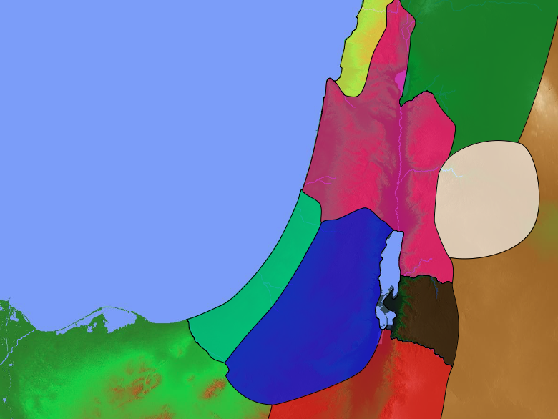
Divided Kingdom
140
Phoenicia
Aram
1 Kings 12–2 Kings 17
Israel
Ammon
Philistia
Judah
Moab
Egypt
Edom

Slide 14
Placing the Prophets
342
Placing the Prophets
Key Dates
931
Obadiah
722
Jonah
Amos
Hosea
Isaiah
Micah
Nahum
Zephaniah
Jeremiah
Lamentations
Joel
Daniel
Haggai
Habakkuk
Ezekiel
Zechariah
Malachi
586

Slide 15

When Isaiah Wrote
453
End of the
Kings of Israel
Pekah
Hoshea
Kings of Judah
Uzziah
Jotham
Ahaz
Hezekiah
Isaiah's 60-Year Ministry
(740-680 BC)
Notes:
15

Slide 16
The Assyrian Threat
454
Assyrian Expansion
Nineveh
Mediterranean
Sea
Aram
Israel
Judah
700s BC
Persian
Gulf
Egypt
Notes:
16

Slide 17
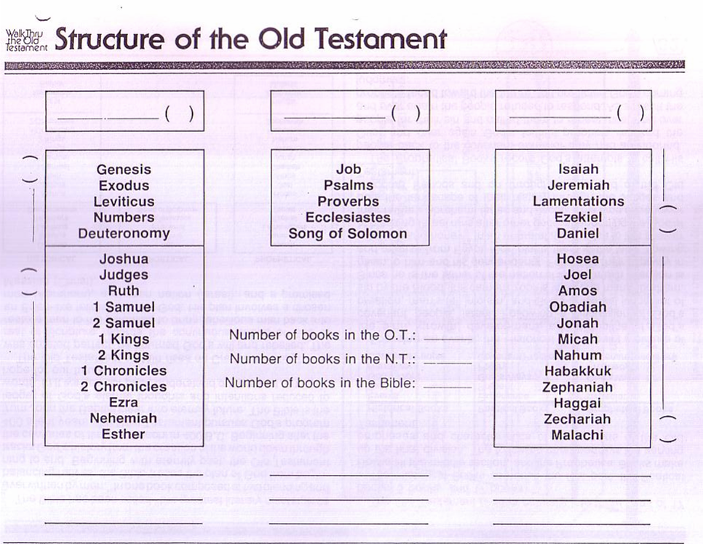
Structure of the Old Testament
36
History
17
Poetry
5
Prophecy
17
5
Major
Law
5
12
Minor
Narrative
12

Slide 18
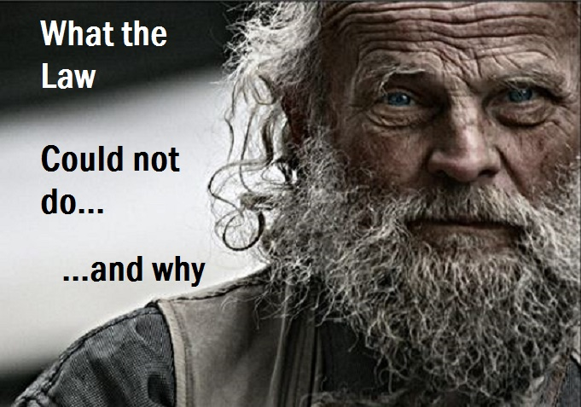
Injustice
It could not make people good.

Slide 19
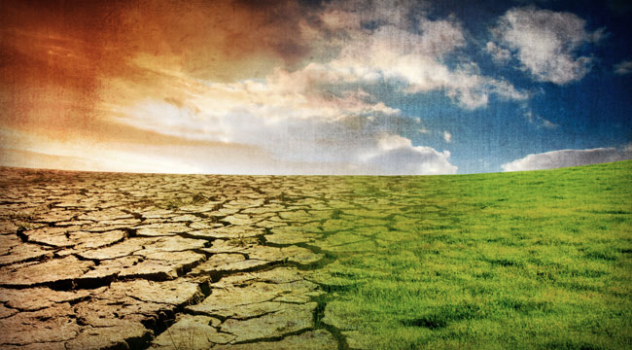
Isaiah's Key Idea
452
343
Judgment
Salvation
Notes:
In contrast to those who say the world will continually get worse until it cools off into oblivion, God says that he will judge the world, but then renew it—or restore it.

Slide 20
Key Word
452
343
Restoration
Isaiah

Slide 21
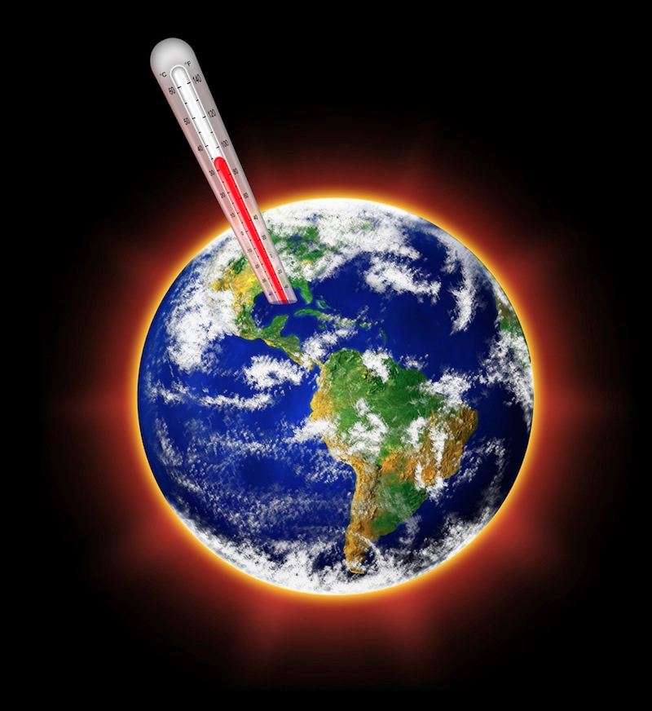
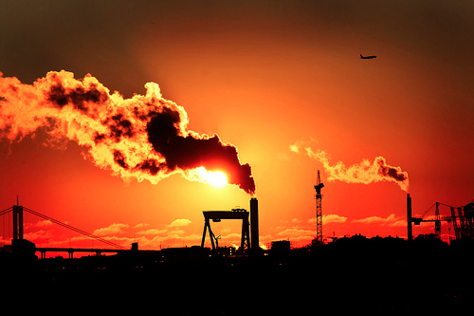
The Talk of the Town Today
452
Global Warming

Slide 22
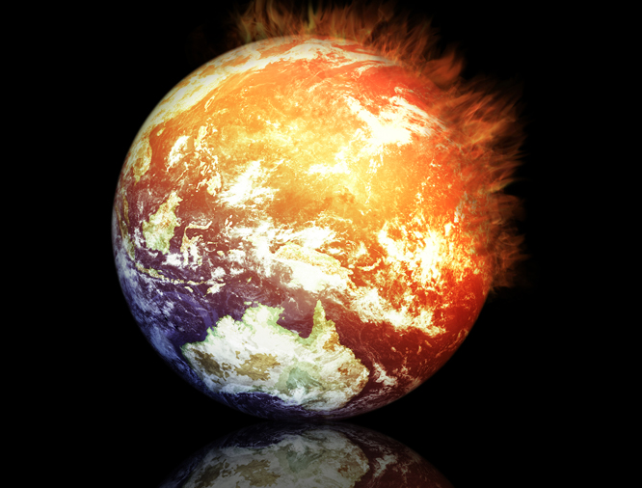
A Study of Isaiah
452
Global Warning

Slide 23
Isaiah: Restoration of the Created Order
Judgment (and Salvation) | Salvation (and Judgment)
Chapters 1–39 | Chapters 40–66
Notes:
23
Isaiah lifts our eyes from the mundane things of this life into the future.

Slide 24
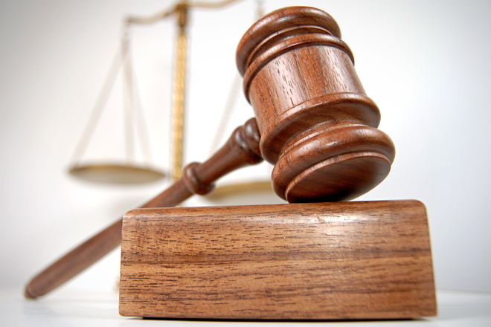
Court Procedure
Charge
Evidence
Verdict

Slide 25

I. The Charge
God's people do not know him (1:2-4)!
Notes:
Israel started a relationship with God 800 years before but could no longer identify him.

Slide 26
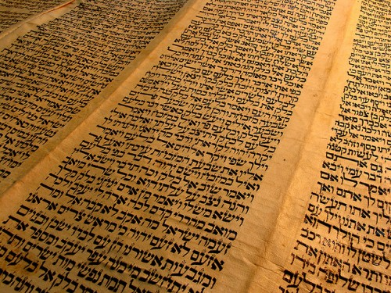
The charge against Judah was not knowing the LORD by forsaking the Mosaic covenant (1:2-4).
Notes:
As in a court of law when the judge enters and the charge is read, let us all stand!

Slide 27

Israel Ignorant (Isa. 1:2)
"Listen, O heavens, and hear, O earth;
For the LORD speaks…"
The Charge (Accusation)
Notes:
The Universe is called as witnesses to God’s accusation as the presiding Judge.

Slide 28
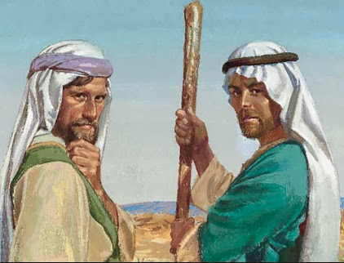
Israel Ignorant (Isa. 1:2)
"Listen, O heavens, and hear, O earth;
For the LORD speaks,
'Sons I have reared and brought up,
But they have revolted against Me'"
(Isa. 1:2 NAU).

Slide 29

Our Three Sons

Slide 30
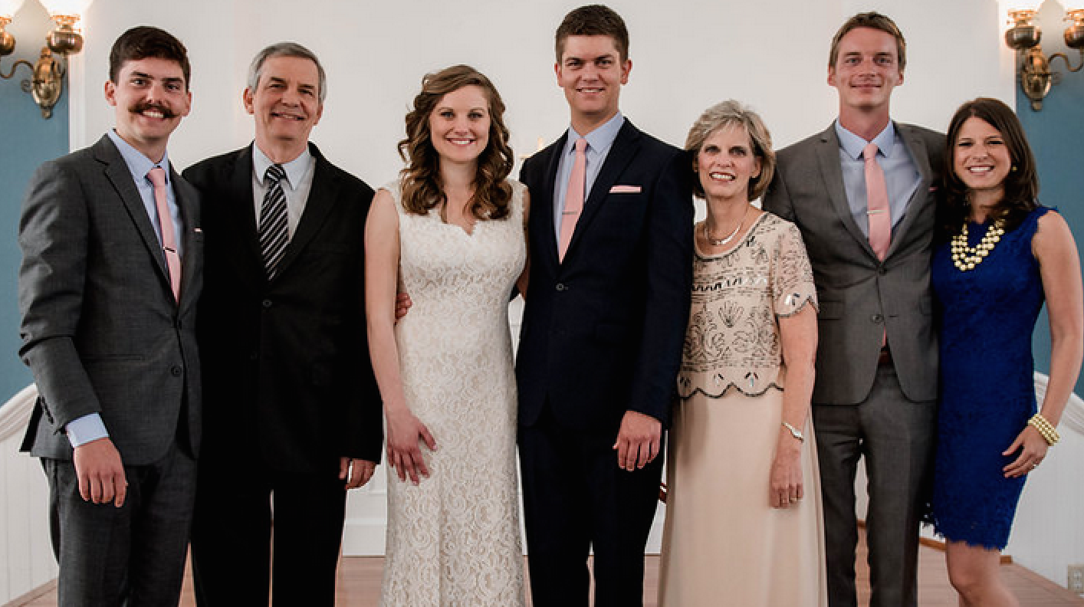
The Griffiths
May 2015
2015
Kurt & Cara (28)
John
(22)
Rick
Susan
Stephen & Katie (25)

Slide 31
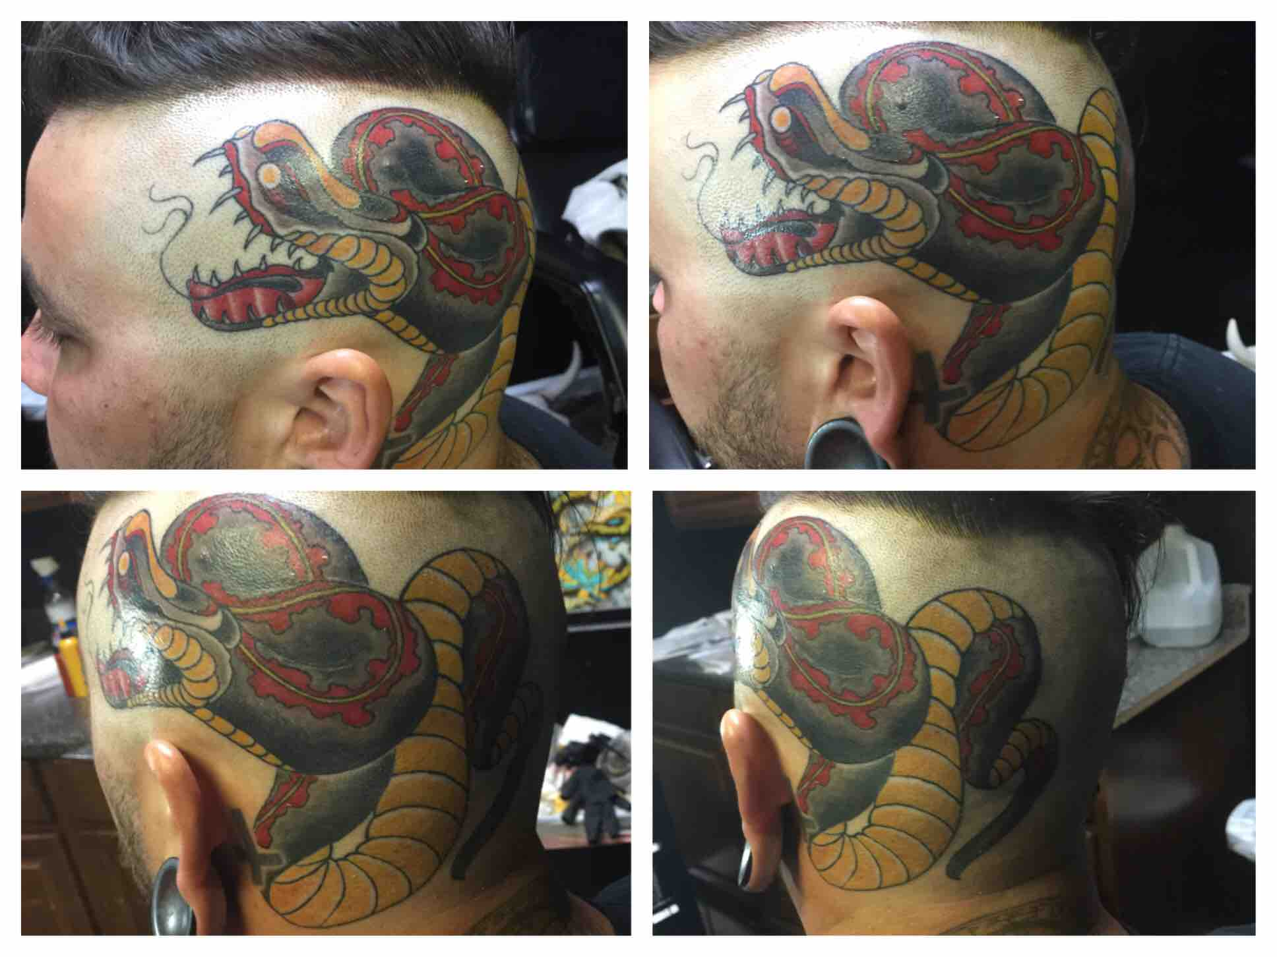
Israel Ignorant (Isa. 1:2)
"Listen, O heavens, and hear, O earth;
For the LORD speaks,
'Sons I have reared and brought up,
But they have revolted against Me'"
(Isa. 1:2 NAU).
Notes:
God says his sons have no idea who he is!

Slide 32
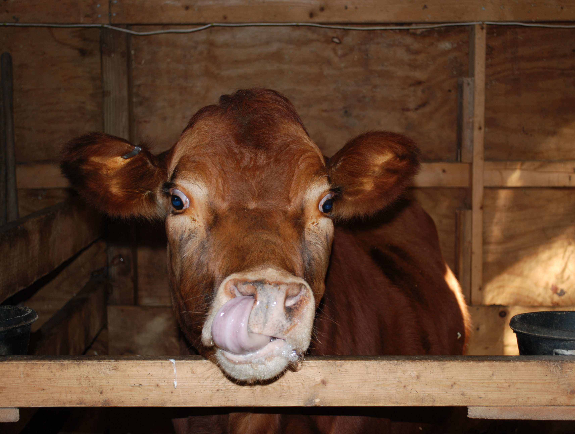
Israel Ignorant (Isa. 1:2)
"An ox knows its owner,
And a donkey its master's manger,
But Israel does not know,
My people do not understand"
(Isa. 1:3 NAU).
Notes:
Even animals know their master cares for them (1:3a).
However, Israel didn’t know God (1:3b).

Slide 33

Do you know God?
Don't just know about him.

Slide 34
I. The Charge
God's people do not know him (1:2-4)!
Notes:
So God made the charge that Judah—and we—don't know him. But is it true? What evidence can God as prosecuting attorney offer? Verses 5-15 give…

Slide 35
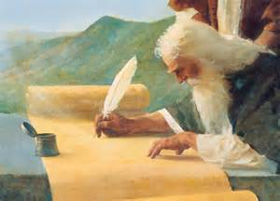
II. The Evidence
Rituals with injustices shows God's people guilty (1:5-15).
Notes:
Exhibits A and B prove us blameworthy of prioritizing rites over inequalities.
Here God is not only the Judge, but he is the Prosecuting Attorney!

Slide 36

Exhibit A
A
EXHIBIT
No repentance (1:5-9)
Notes:
Judah was like a guilty victim where further beating won't do any good (1:5-6).
God seeks to use discipline and difficulty to teach us his ways—practices that are actually in our own best interest.
However, at some point, even further punishment will not turn the unrepentant around.
God's punishment by Assyria ravaged Judah's cities but still left a remnant (1:7-9).

Slide 37
Exhibit B
B
EXHIBIT
Rituals without justice only mocked God (1:10-15)
Notes:
Judah's leaders were no better than the immoral rulers of Sodom and Gomorrah (1:10).
God despised bloody hands giving sacrifices, offerings, monthly and annual festivals, and prayers (1:11-15).

Slide 38
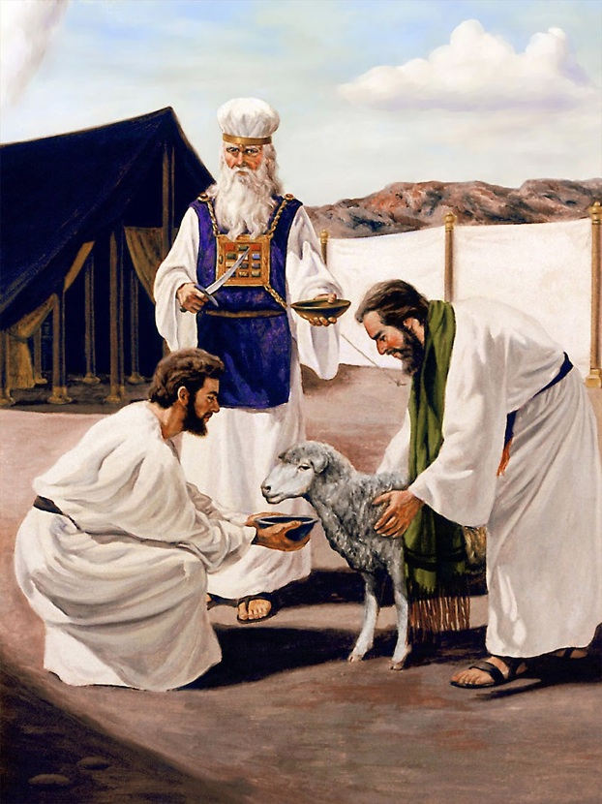
Jewish Rituals
Sacrifices

Slide 39
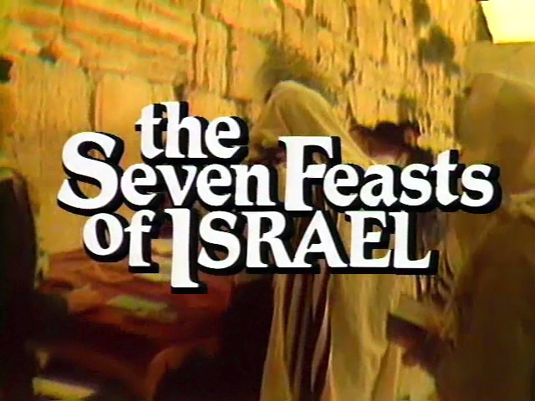
Jewish Rituals
Feasts

Slide 40
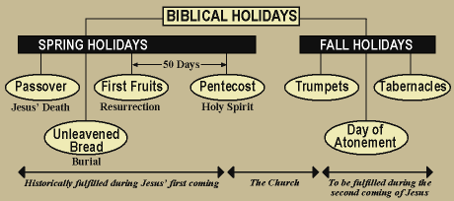


Jewish Rituals
Feasts
Notes:
http://richardwaynegarganta.com/Feasts%20and%20Sacrifices.htm

Slide 41
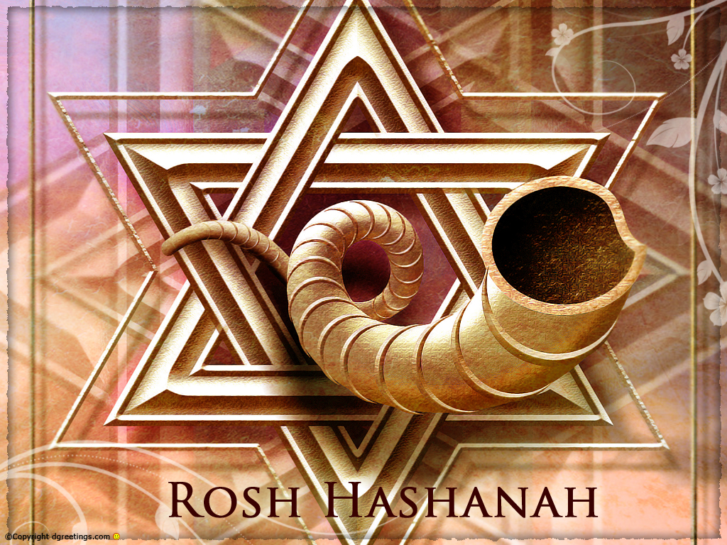
Jewish Rituals
Feast of Trumpets

Slide 42
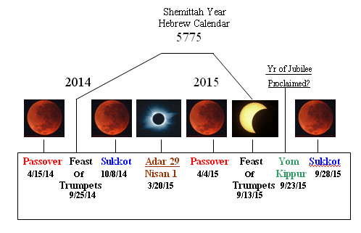
Jewish Rituals
Feasts
Notes:
The Blood Moons; How Do You Spell WAR?
Monday, April 14, 2014 6:43
http://beforeitsnews.com/prophecy/2014/04/what-the-blood-moons-really-mean-2460362.html
Accessed on 27 Sep 2015
There has been a lot of chatter about the upcoming tetrad of eclipses occurring on Jewish feast days and what they mean in relation to end times Bible prophecy. The reason for the interest is that in the past, during tetrad periods that occurred on feast days, monumental prophetic events occurred in regards to Israel. Thus logic dictates to ask the question; if monumental things occurred in the past during these feast tetrad periods, will they occur in this tetrad period?
To provide you with a more detailed account of the tetrad data here is an excerpt from The Coming Epiphany, after which I will discuss the implications in light of current world events.
From The Coming Epiphany; Chapter 11
2014/2015 Lunar and Solar Eclipses
In 2014 and 2015 there will be 4 blood moon total lunar eclipses all falling on feast days.
1. Passover, April 15, 2014
2. Tabernacles October 8, 2014
3. Passover, April 4, 2015
4.Tabernacles, September 28, 2015
What is significant about this? A tetrad of lunar eclipses on feast days has only occurred two times in the last 500 years; 1949/50, and 1967/68. During each of those tetrads of total eclipses Israel was at war.
Though Israel was declared an independent state sixty years ago in 1948, the war with its neighbors began after its first day and lasted for a year. Therefore, the first lunar eclipse of 1949 occurred during this war for the establishment of Israel. The next tetrad began on Passover 1967, which was just six weeks before the Six-Day-War. Therefore, these two significant wars of Israel were covered by each tetrad period.^{[1]}
The time before those tetrads of eclipses on feast days was in 1493/4. In 1492 the Jews were kicked out of Spain. Another interesting fact is that all of these tetrads occurred in Hebrew "pregnant years" or years with 13 months. These facts lead us to wonder if the upcoming tetrad is a sign from God that something significant will occur in 2014/15 in regards to Israel? Will they be involved in another major war at that time, possibly even the end times war with the antichrist, when Israel is surrounded by armies and has to flee into the wilderness?
And when ye shall see Jerusalem compassed with armies, then know that the desolation thereof is nigh. Then let them which are in Judaea flee to the mountains; and let them which are in the midst of it depart out; and let not them that are in the countries enter thereinto. (Luke 21:20-21)
This is something to ponder and watch for. There is something else involving eclipses that is of significance around this time. There are two solar eclipses that align on significant dates.
1. Adar 29/Nisan 1 (Beginning of the religious calendar): March 20-21, 2015 Total eclipse
2. Rosh Hashanah: September 14, 2015 | September 13, 2015 Partial eclipse
You have the religious year beginning with the total solar eclipse, two weeks later a total lunar eclipse on Passover, and then the civil year beginning with the solar eclipse followed two weeks later by another total blood red moon on the Feast of Succoth all in 2015.^{[2]}
Again, what do all these celestial occurrences mean? Are they signs for us from God that this will be the time when Jews and Christians will be persecuted? Are these eclipses related in some way to the rapture? We will have to wait and see, but if the time of the first lunar eclipse on Passover April 15, 2014 is near the time when Israel is to be at war with the antichrist, that would imply April 2014 to be near the midpoint of the 70th Week, which would further imply a 2017 Second Coming.
What does all this tetrad data mean in light of current events? I perceive that the world is on the cusp of several major events occurring, such as a conquering world power taking over the world, WW3, the worldwide financial collapse, and a worldwide pandemic—Seals 1-4. These things have been looming for years, will they be unleashed during this tetrad period? That remains to be seen, but based on what happened during the last two tetrads, I would say that is a very strong possibility.
Let me give you a few facts about the first blood moon eclipse of the tetrad which occurs on 4/15/14. It is not visible in the Mid East, but will have its greatest visibility over the United States, Canada, and some of South America. The center of the visibility area is at about the same longitude as Yellowstone. Over Yellowstone the eclipse will be the greatest at approximately 1:47 AM, Hmm…interesting number. Also the total eclipse will have a duration of 77 minutes and 48 seconds. I am not suggesting that this means anything, just pointing out the data. Here are the links; http://eclipse.gsfc.nasa.gov/OH/OH2014.html, http://www.accuweather.com/en/features/trend/total_lunar_eclipse_will_darke/25463492
Let me also explain that some people are confusing the blood moon eclipses of the tetrad with the blood moon listed in Revelation 6:12 -14.
12 And I beheld when he had opened the sixth seal, and, lo, there was a great earthquake; and the sun became black as sackcloth of hair, and the moon became as blood;
13 And the stars of heaven fell unto the earth, even as a fig tree casteth her untimely figs, when she is shaken of a mighty wind.
14 And the heaven departed as a scroll when it is rolled together; and every mountain and island were moved out of their places.
I do not think that the any of the eclipses of the tetrad are the blood moon talked about in Revelation 6. Notice in these passages that other events are occurring such as a worldwide earthquake, meteor shower, darkening of the sun, atmosphere rolling away. I think those events are more indicative of a Planet X passage. Plus the Sixth Seal is also the time of the rapture, as you will see in the verses below, and we are not at that point yet, because we have not seen Seal 5—the great persecution at the hands of the antichrist—yet.
15 And the kings of the earth, and the great men, and the rich men, and the chief captains, and the mighty men, and every bondman, and every free man, hid themselves in the dens and in the rocks of the mountains;
16 And said to the mountains and rocks, Fall on us, and hide us from the face of him that sitteth on the throne, and from the wrath of the Lamb:
17 For the great day of his wrath is come; and who shall be able to stand?
Thus my take on the blood moon tetrad is that sometime during the period—between the first and last eclipse—that we are likely to see Israel at war—WW3. And since Israel established herself as a nation in the first tetrad war, and she took control of Jerusalem in the second tetrad war, that maybe she will regain the Temple mount in the possible upcoming third tetrad war, which would pave the way for the Temple and abomination of desolation.
As always, time will tell; watch and pray. Take ye heed, watch and pray: for ye know not when the time is. Mark 13:33
Are you ready for the end times? Read The Coming Epiphany today for FREE.
http://www.fivedoves.com/letters/may2008/danielm517.htm
http://www.omegaletter.com/articles/articles.asp?ArticleID=6285

Slide 43

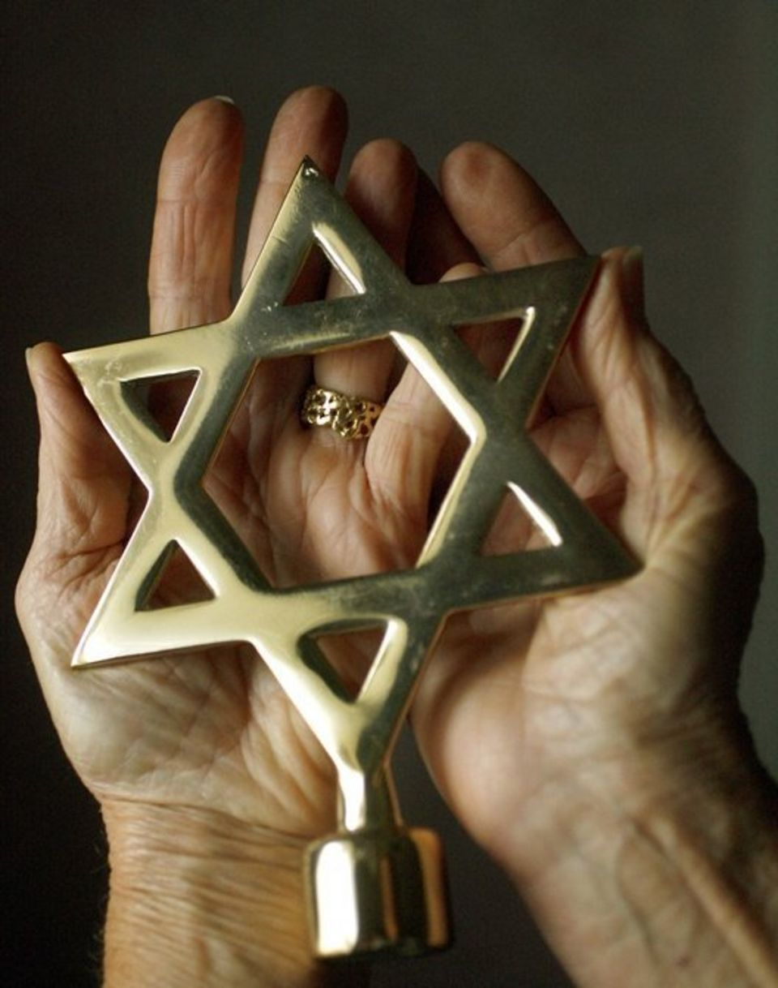
Jewish Rituals
Hand washing

Slide 44
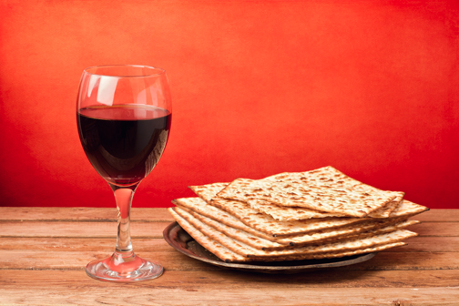
Jewish Rituals
Passover

Slide 45
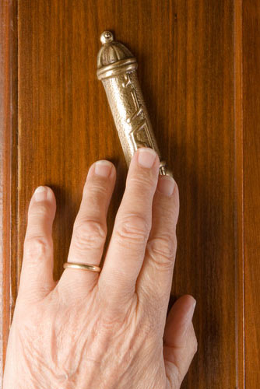
Jewish Rituals
Mezuzah

Slide 46
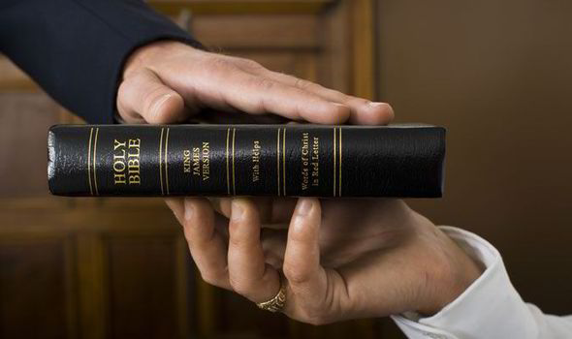
Christian Rituals
Subtitle

Slide 47
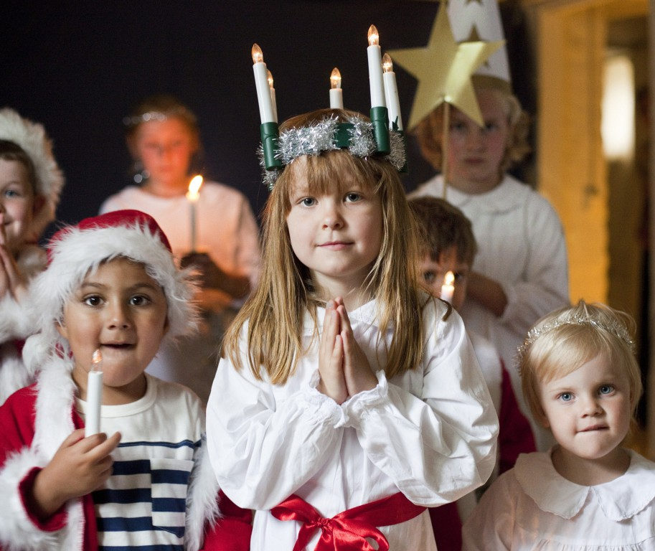
Church Services
Religious Rituals Today

Slide 48
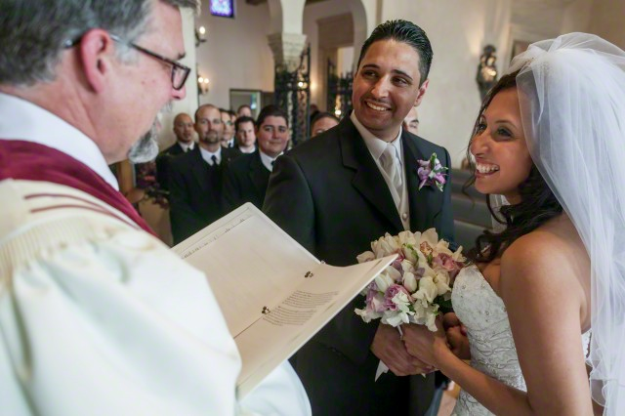
Marriage
Religious Rituals Today
Notes:
http://www.slideshare.net/anthony_morgan/marriage-in-the-christian-tradition slide 10

Slide 49
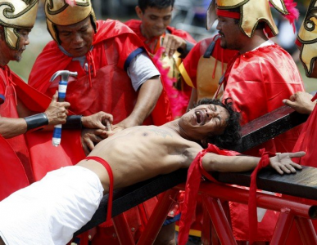
Crucifixion
Philippines

Slide 50
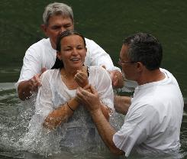
Baptism
Religious Rituals Today

Slide 51

Prayer
Religious Rituals Today

Slide 52

Lord's Supper
Religious Rituals Today

Slide 53
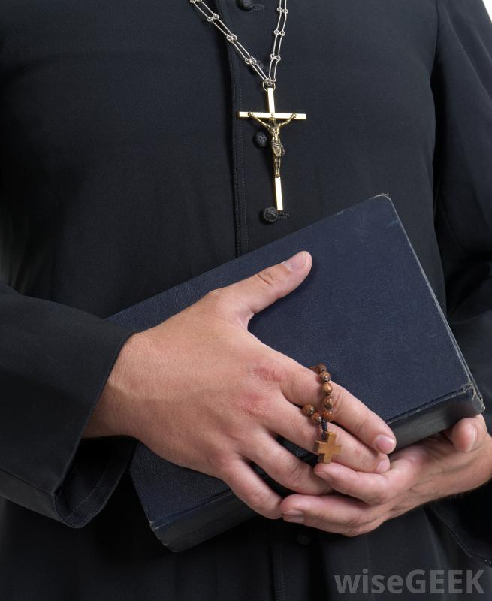
Clothes
Religious Rituals Today

Slide 54
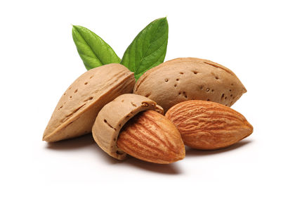
Food
Religious Rituals Today

Slide 55

Lent
Religious Rituals Today

Slide 56

Do you prioritize rituals over justice?
Notes:
Do you treat those under you fairly?
This week I have been tempted to dismiss students for laziness—and even did it to one student on Friday—but this passage helped me repent of my injustice!
Do you pay what you promised?
Would anyone have a case against you before God?

Slide 57
I. The Charge
God's people do not know him (1:2-4)!
Notes:
So God made the charge that Judah—and we—don't know him. But is it true? What evidence can God as prosecuting attorney offer? Verses 5-15 give…

Slide 58
II. The Evidence
Rituals with injustices shows God's people guilty (1:5-15).
Notes:
Exhibits A and B prove us blameworthy of prioritizing rites over inequalities.

Slide 59
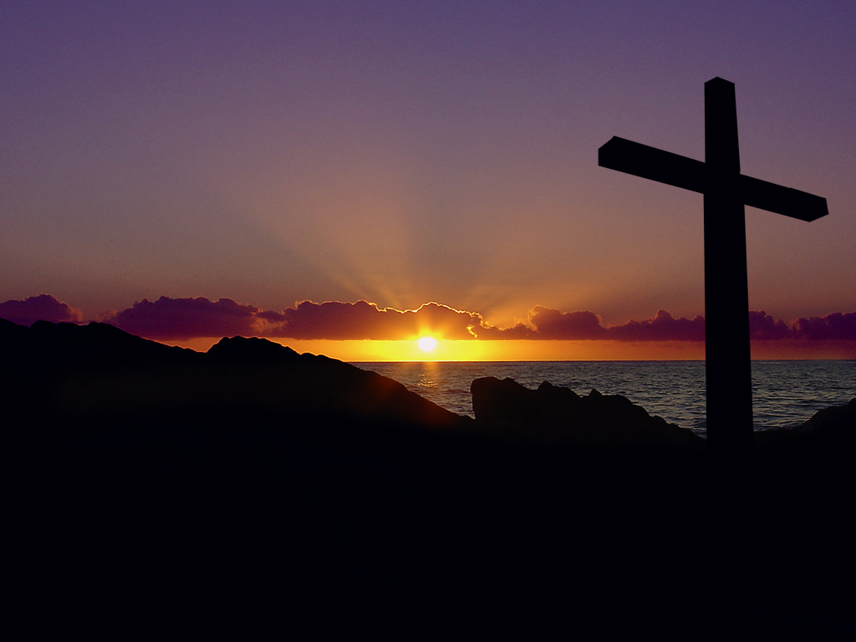
III. The Verdict
When rituals replace relationship, repent for restoration (1:16-31)
Notes:
Turn to God instead of religion—so don't be religious, be restored!
This comes through a change of mind (repentance) followed by the fruits of repentance (justice)

Slide 60
Isaiah's Key Idea
452
343
Judgment
Salvation
The blessing of restoration after judgment exhorted Judah to aid the oppressed (1:16-31)
Notes:
Actions toward the defenseless would result in either prosperity or judgment (1:16-20).
• Giving justice would result in eating the best food (1:16-19).
• Rebellion by injustice would end in "being eaten" by death (1:20).
Did Judah repent as God asked (1:18-20)? Not really.
• Judah has some brief periods of good rulers after this but the people continued their sinful ways.
• Unfortunately, even good kings like Hezekiah and Josiah could not turn the tide, so eventually both the leaders and the people sinned to the point of no return and were judged.
When will the hypocritical worship and social evils end (1:10-23)?
• This continued until the Babylonians conquered Judah over 100 years later in 586 BC (2 Kings 25).
• Not until the righteous Davidic King Jesus rules will the city be called "the City of Righteousness, the Faithful City" (1:26 NIV).

Slide 61
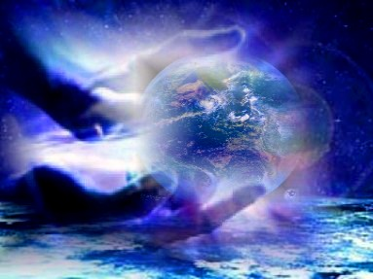
God will follow his judgment against Jerusalem's injustices and idolatry with restoring the city [when Messiah rules] (1:21-31).
Notes:
Injustice will be removed by God's judgment (1:21-25).
Just judges will replace idolatrous rebels (1:26-31).
When will God avenge his enemies and judge evil (1:24-31)?
• This won't happen until the return of Christ.
• God is the ultimate example of patience, so he still calls us to repent.

Slide 62
How should we respond to an all-knowing Judge who takes us to court?
You

Slide 63
I. The Charge
God's people do not know him (1:2-4)!
Notes:
So God made the charge that Judah—and we—don't know him. But is it true? What evidence can God as prosecuting attorney offer? Verses 5-15 give…

Slide 64
II. The Evidence
Rituals with injustices shows God's people guilty (1:5-15).
Notes:
Exhibits A and B prove us blameworthy of prioritizing rites over inequalities.

Slide 65
III. The Verdict
When rituals replace relationship, repent for restoration (1:16-31)
Notes:
Turn to God instead of religion—so don't be religious, be restored!
This comes through a change of mind (repentance) followed by the fruits of repentance (justice)

Slide 66
The Main Idea
When rituals replace relationship, repent for restoration.
Notes:
Turn to God instead of religion—so don't be religious, be restored!
This comes through a change of mind (repentance) followed by the fruits of repentance (justice)

Slide 67

Choose Restoration!
Do you know God?
Security in Ritual?
Sin of Injustice?
Notes:
Do you have a relationship with God? Or are you one of these children of verses 2-3 that have rebelled or don't understand God?
Do you put your security in any rituals?
• "If I only can take the Lord's Supper, I will be healed."
• "I was baptized, so I must be a Christian."
• "I pray three times a day before meals and even fast occasionally!"
What sin of injustice do you need to abhor? Don't just dislike sin—disdain it!

Slide 69

OT Sermons link at biblestudydownloads.com
Download this presentation for free!

